Slide 1
C++ Application
Callum Owen-Bridge, Karl Myers, Keiran Brown

Slide 2
Key Points
Student Options
Enrolling
Programme Options
Course Options
Creation
Transcripts
MySQL Database
Security

Slide 3
Database
MySQL Database
Implements Rules and Security
Allows for data to be easily stored elsewhere

Slide 4
Contingency and Security
User Accounts can be Created
Permissions Implemented
Secure Logins
Application Implements Backup and Restore functions

Slide 5
Student Options
Create a Student
Add Batch from File
Edit a Student
Delete a Student
Verification

Slide 6
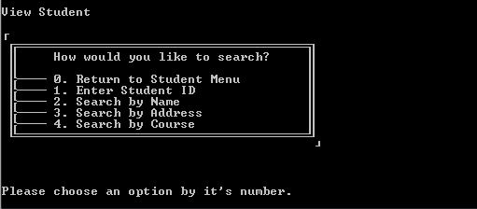
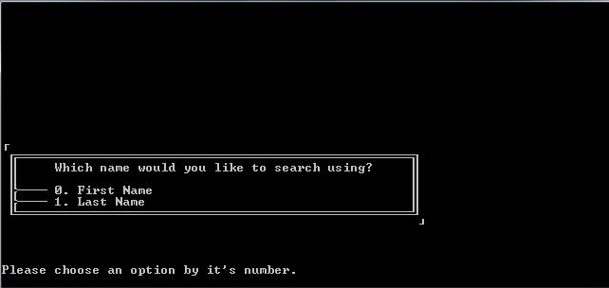
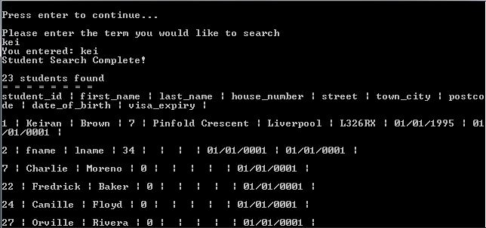
Viewing a Student
Keyword Search
Search by
Name
Address
Course
All details shown to users with permission

Slide 7
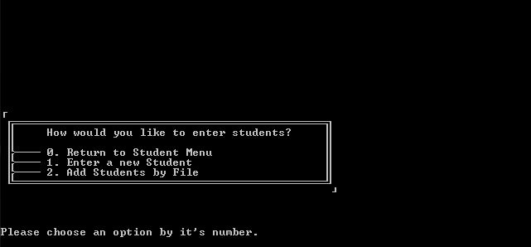
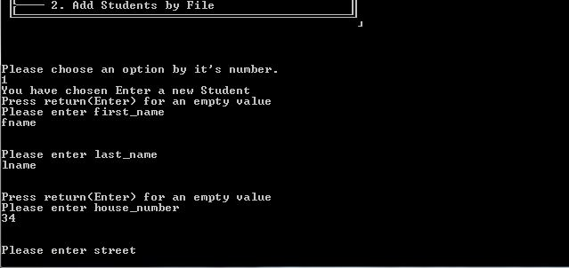
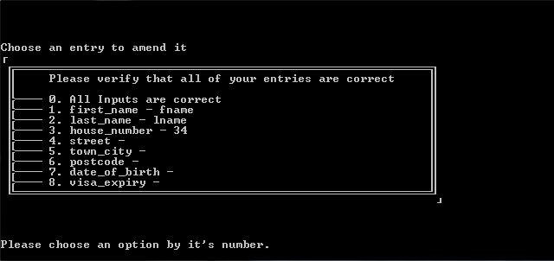
Creating a Single Student
Enter each value in turn
Each value entered verified
Data must be correct
Allowed to amend afterwards.

Slide 8
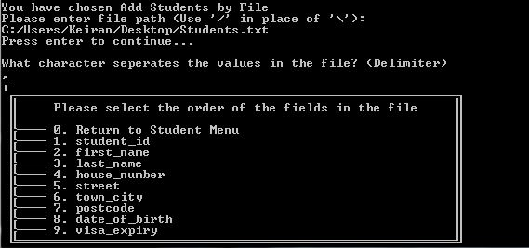
Creating Many Students
Choose file
Except, choose to add using a file.
Student IDs are automatically fixed if problems occur.

Slide 9
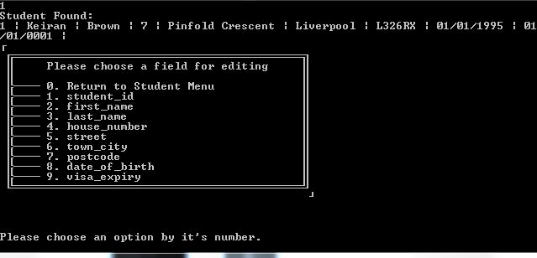
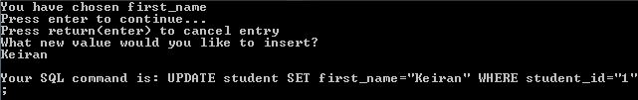
Amend a Student
Uses standard student search
Allows choice of which field to edit
Retains verification of data
Doesn’t make changes until data is correct.

Slide 10
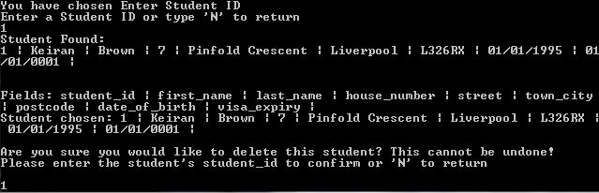
Deleting a Student
Uses standard student search
Ensures user deletes correct student by having them enter the ID
Better verification than a simple yes or no answer

Slide 11
Transcripts
Single Student Transcript
Batch of Transcripts
Saving Transcripts

Slide 12
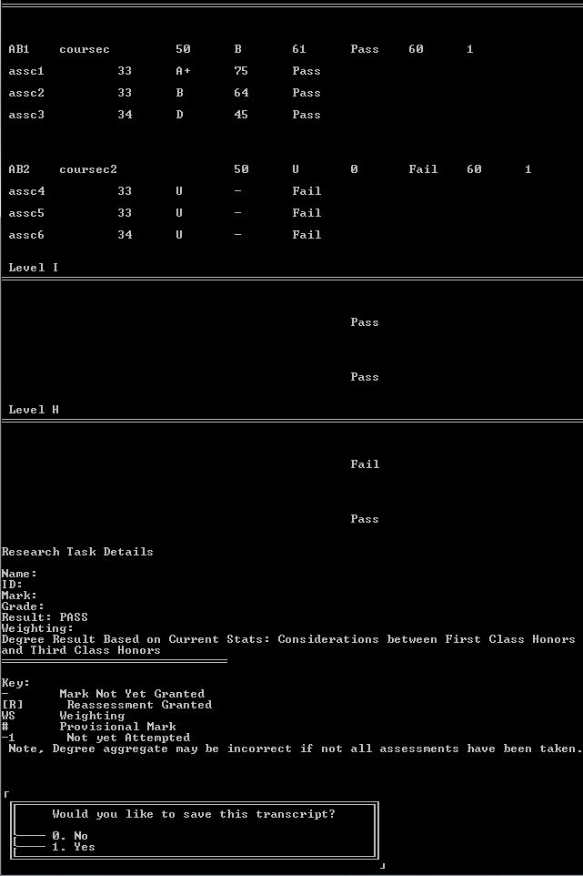
Transcripts – Single
Student Transcripts
Aggregates
Course
Level
Infers information about student based on database
Takes into account that a student might be missing details

Slide 13
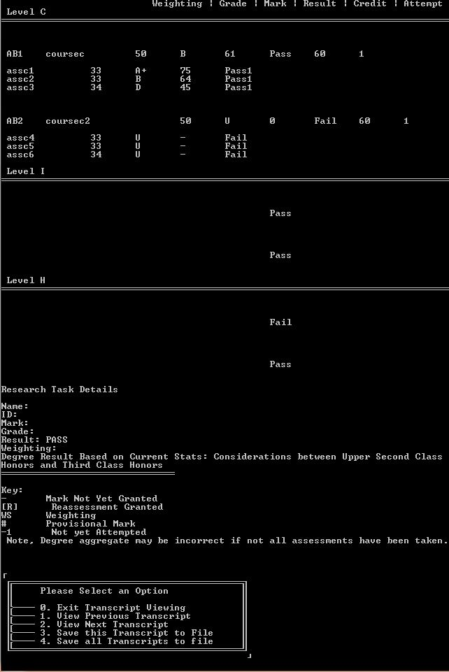
Transcripts – Batch
User specifies many students
Allows navigation between different transcripts
Can save current or all

Slide 14
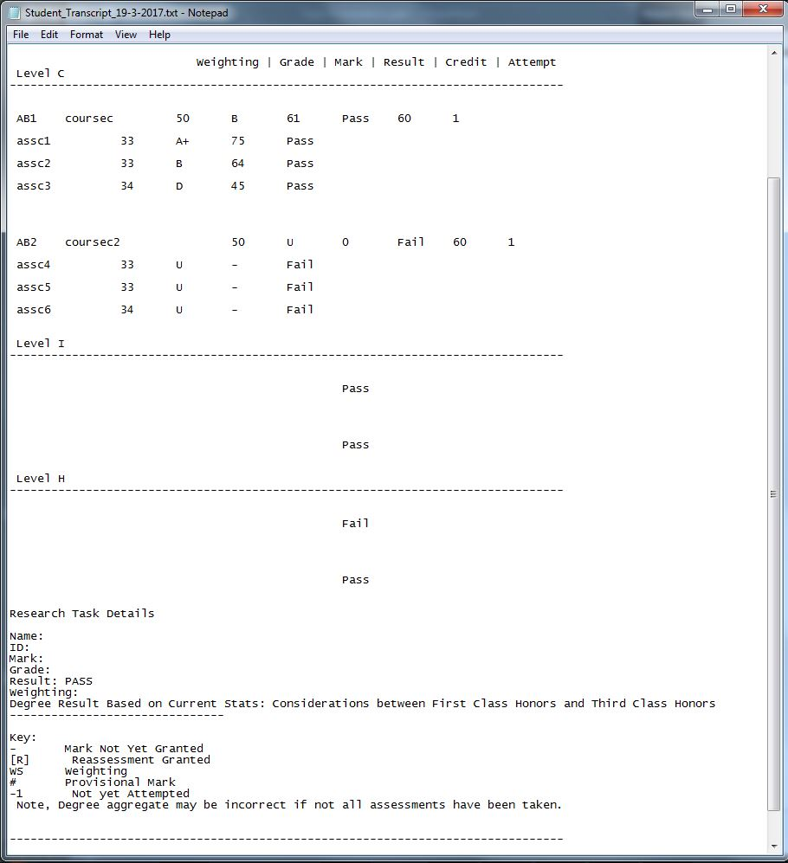
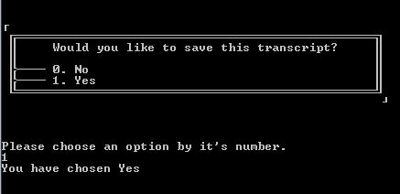
Transcripts – File

Slide 15
Course Options

Slide 16
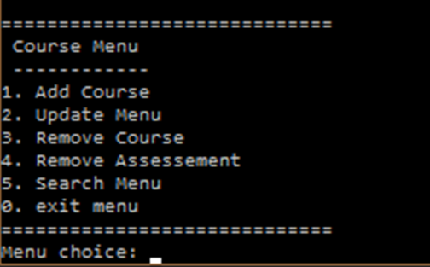
Course Options
Adding a Course
Adding and Assigning Assessments
Updating Courses and assessments
Deleting a Courses and Assessments

Slide 17
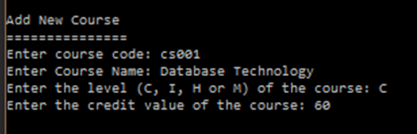
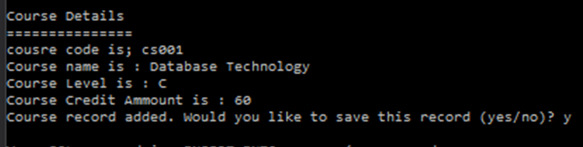
Adding a course
Navigate To course Menu
Choose Add course
Error Checking
Level
Credit Value

Slide 18
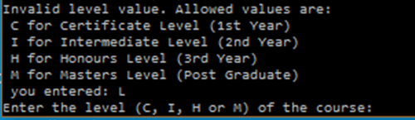
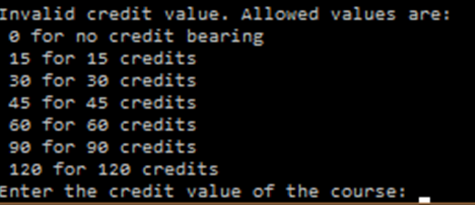
Adding a course
Navigate To course Menu
Choose Add course
Error Checking
Level
Credit Value

Slide 19
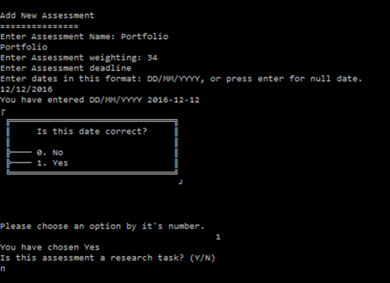
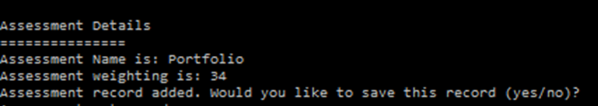
Assigning assessments
Assessments Assigned Immediately after the Course is Added
Error Checking
Assessment Weightings

Slide 20
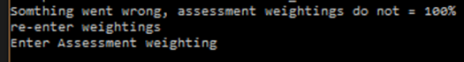
Assigning assessments
Assessments Assigned Immediately after the Course is Added
Error Checking
Assessment Weightings

Slide 21
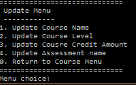
Updating
Navigate from Course Menu
Updating Course
Updating Course Name
Updating Course Level
Updating Course Credit Amount
Updating Assessment
Assessment name

Slide 22
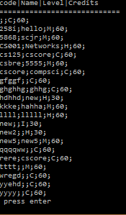
Updating
Navigate from Course Menu
Updating Course
Updating Course Name
Updating Course Level
Updating Course Credit Amount
Updating Assessment
Assessment name

Slide 23
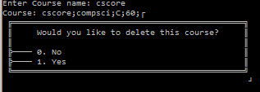
Deleting
Removing a Course
With Course Code
With Course Name
Removing an Assessment
With Assessment ID
With Assessment Name

Slide 24
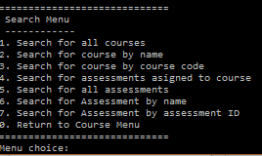
Searching and Displaying
Navigate To Search Menu
Searching Courses
With Course Code
With Course Name
All Courses
Searching Assessments
With Assessment ID
With Assessment Name
All Assessments
Assessments Assigned to a Course

Slide 25
Programme Options

Slide 26
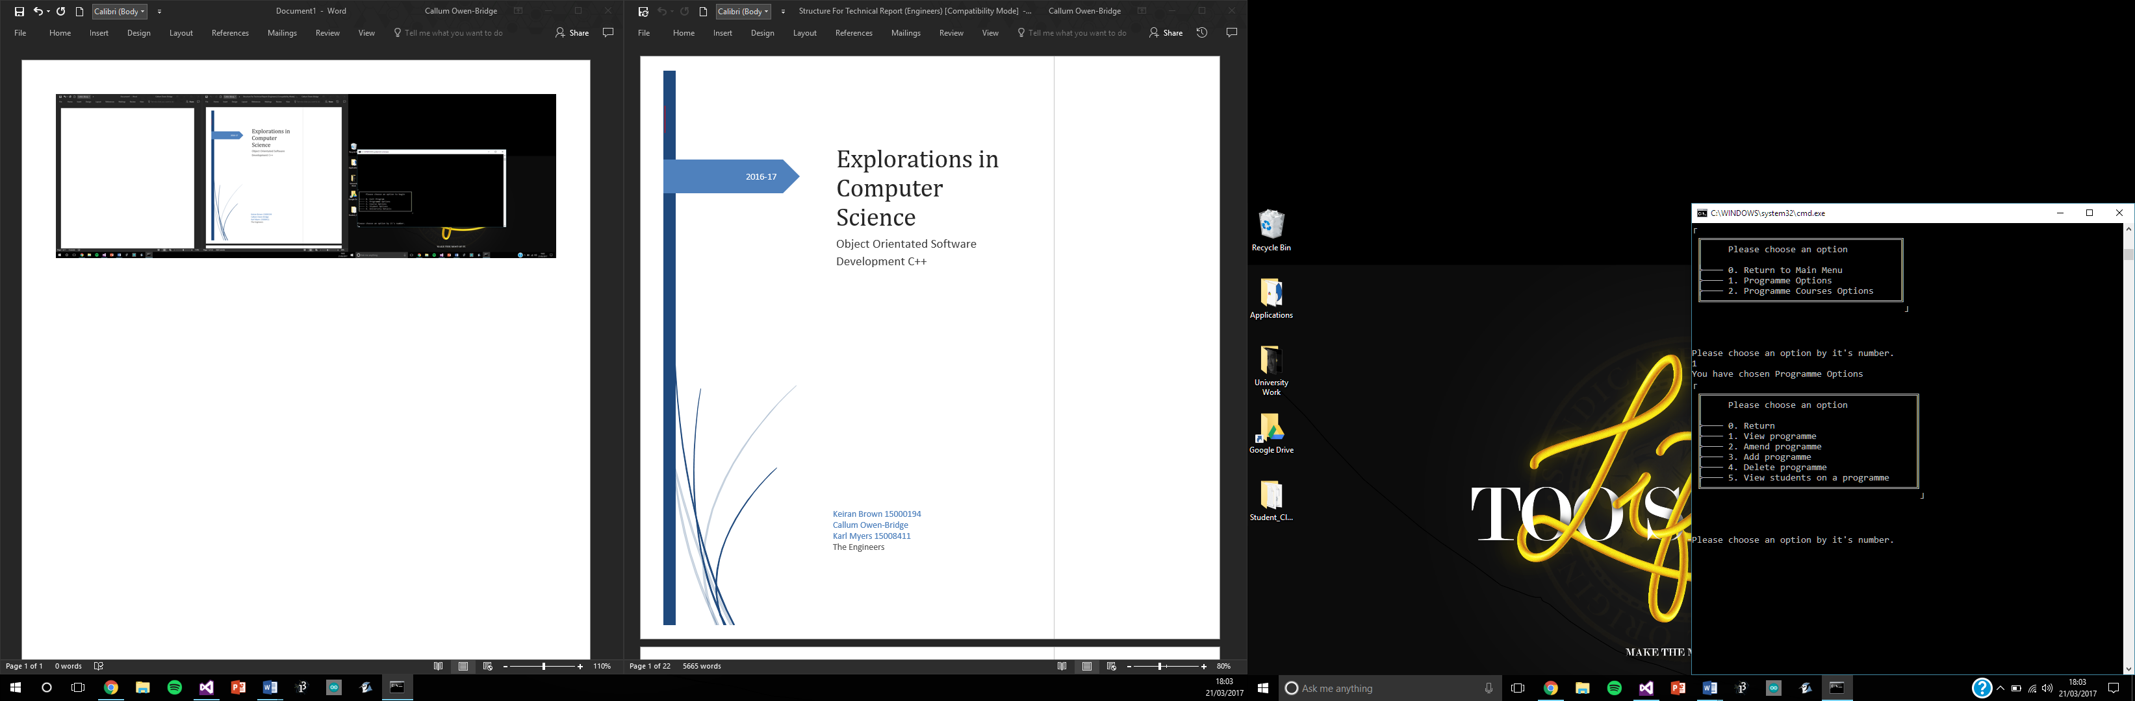
Programme of Study
View the programmes
Amend programme
Add programme
Delete programme
View students on programme

Slide 27
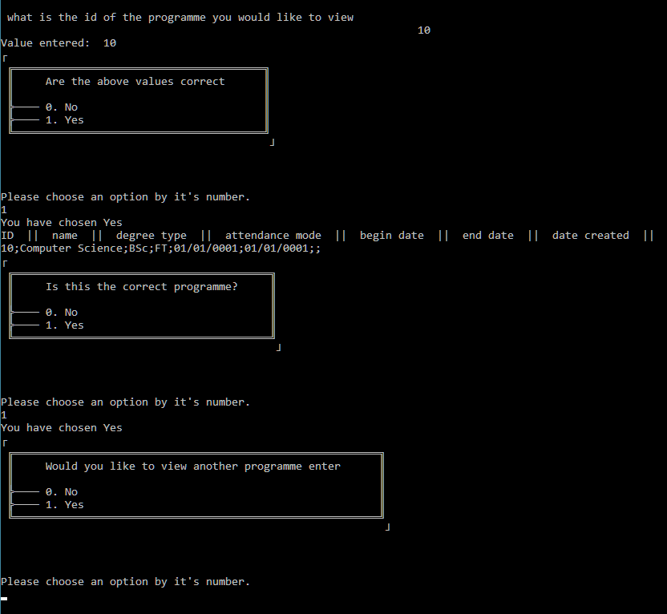
View programme
Enter a programme ID
Details shown

Slide 28
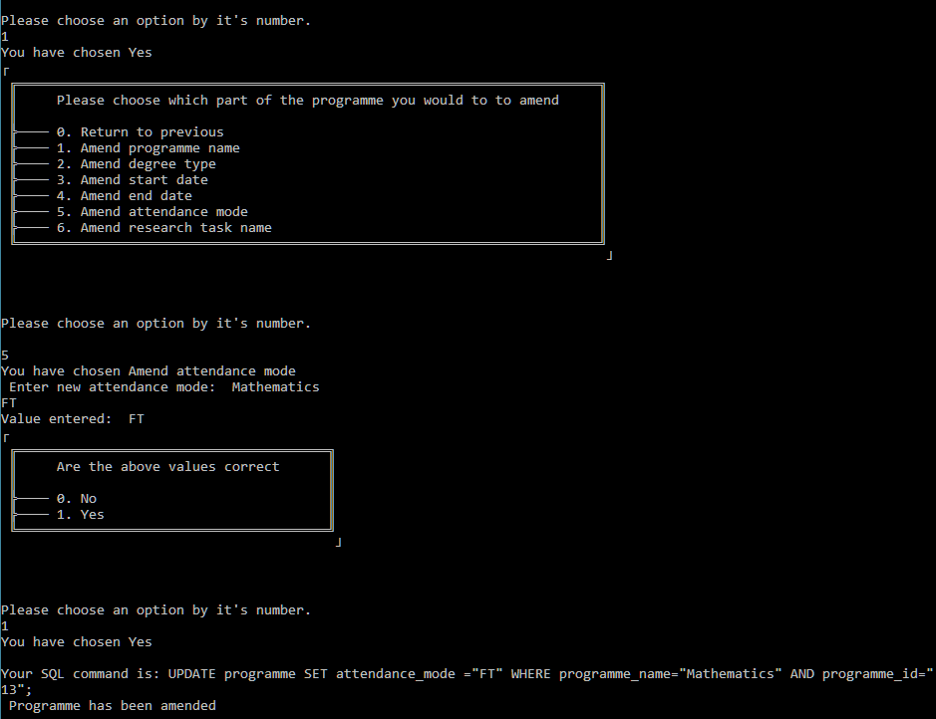
Amend a programme
Amend individual parts of a programme

Slide 29
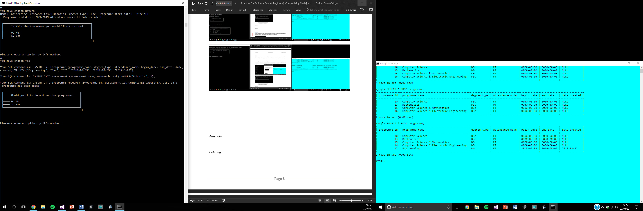
Add a programme
No duplicates

Slide 30
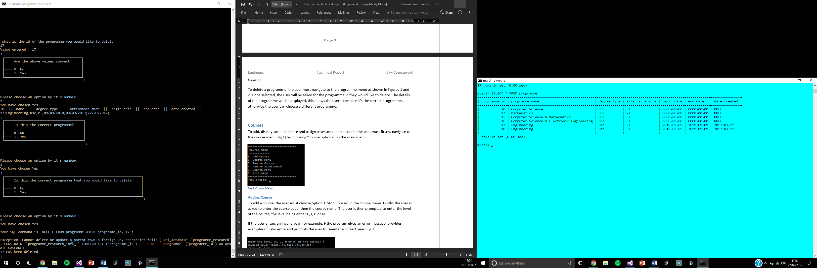
Delete a programme
Input check

Slide 31
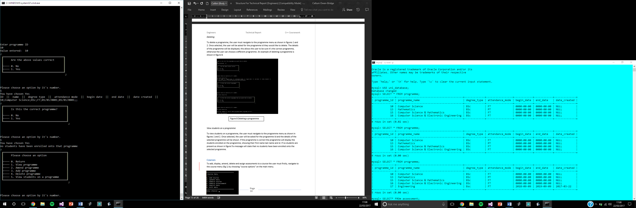
View students on programme
Provides a list of enrolled student ids

Slide 32
Programme Courses

Slide 33
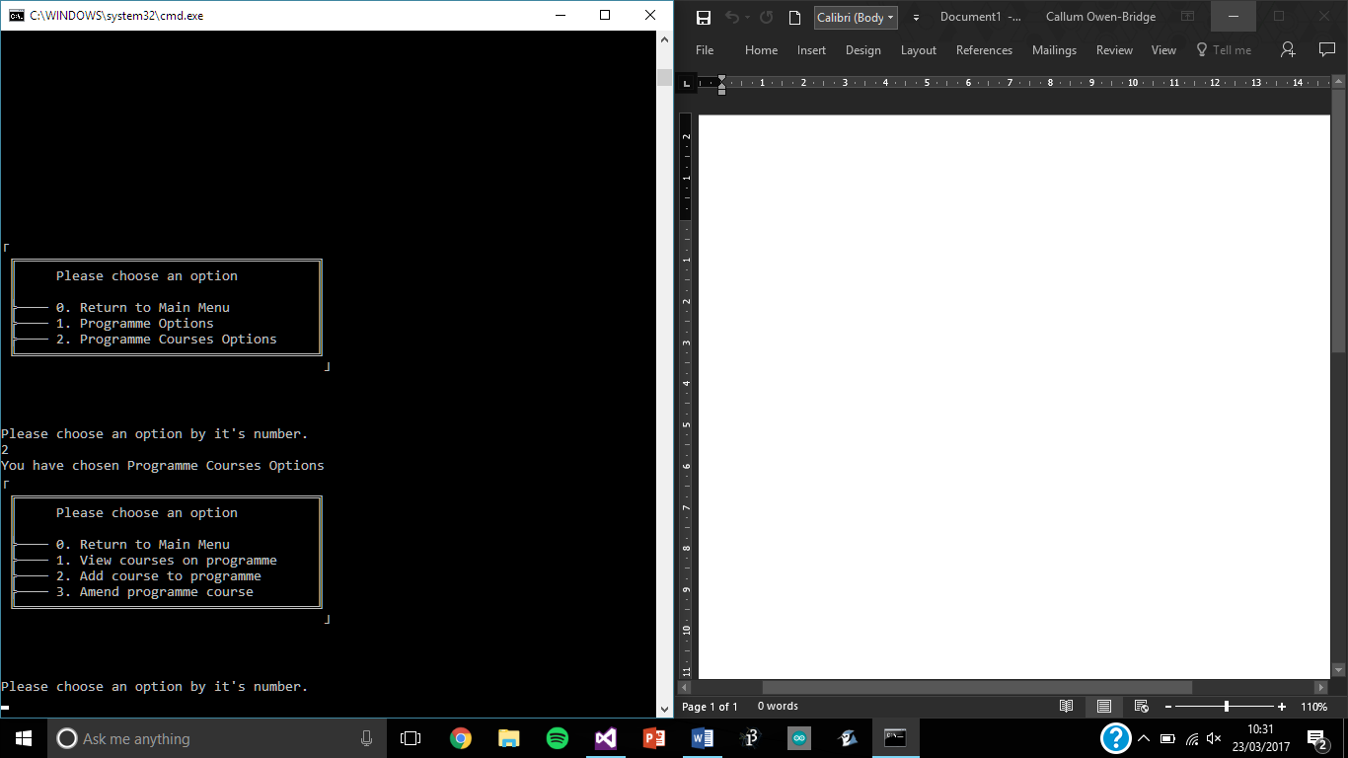
Programme courses
View courses on a programme
Add courses to a programme
Amend a programme courses

Slide 34
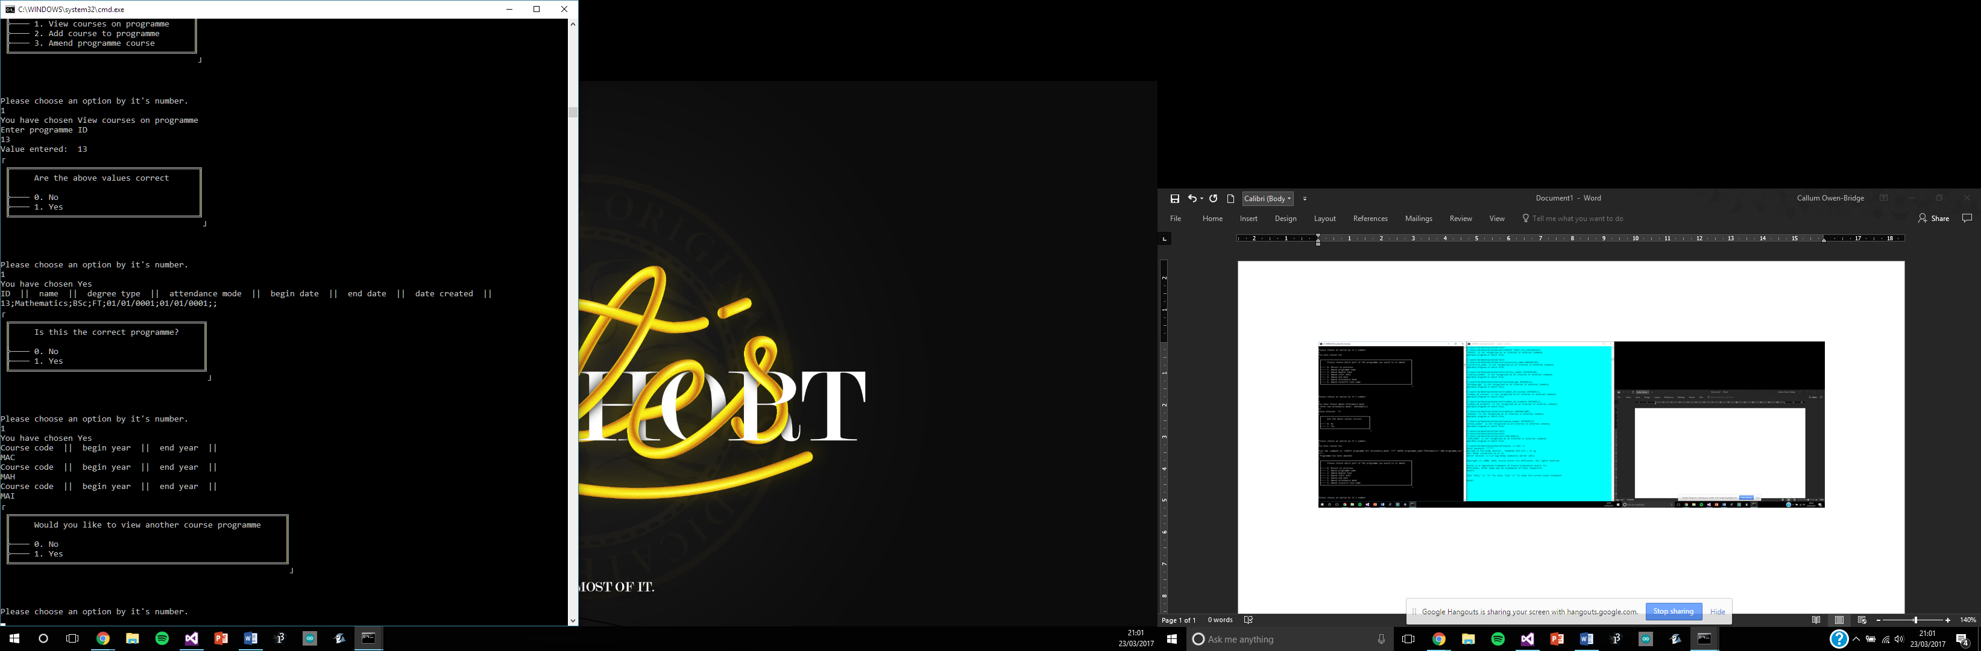
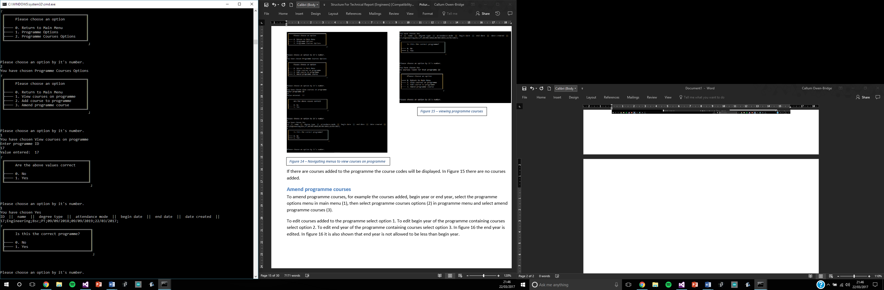
View courses on a Programme
Displays a list of courses

Slide 35
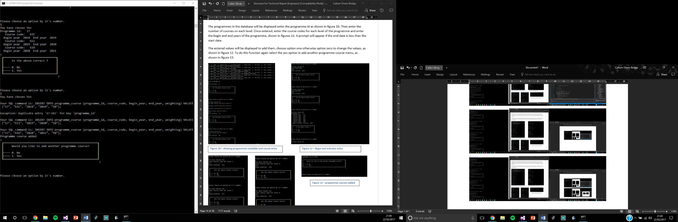
Adding courses - Programme courses
Add courses per level
Add start and end years of each course
Automatic weighting

Slide 36
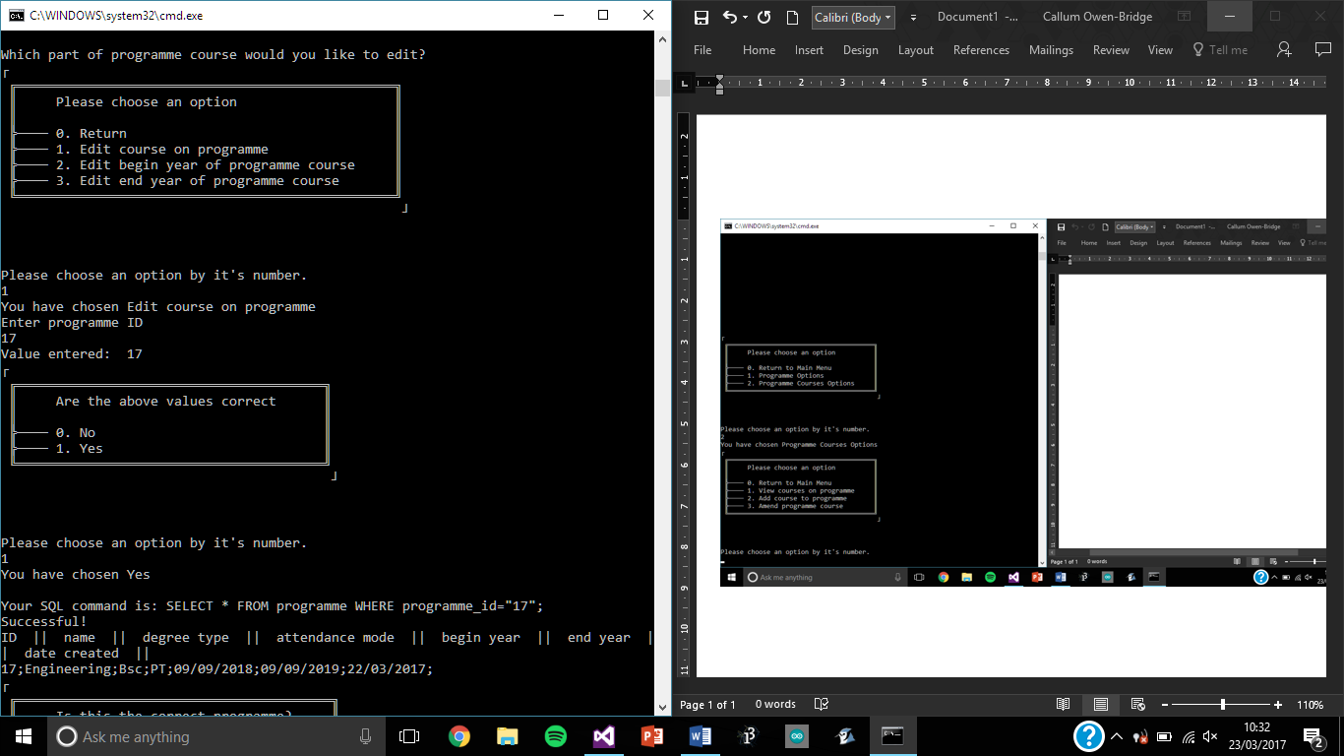
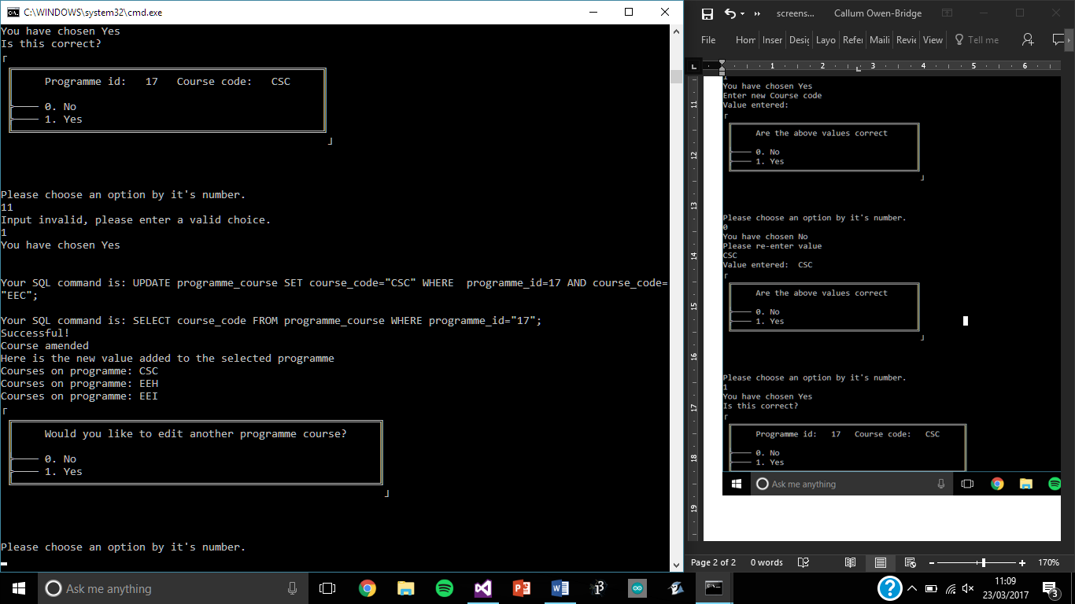
Amend Programme courses
Amend specific courses
Amend start and end years

Slide 37
Student Programme Options

Slide 38
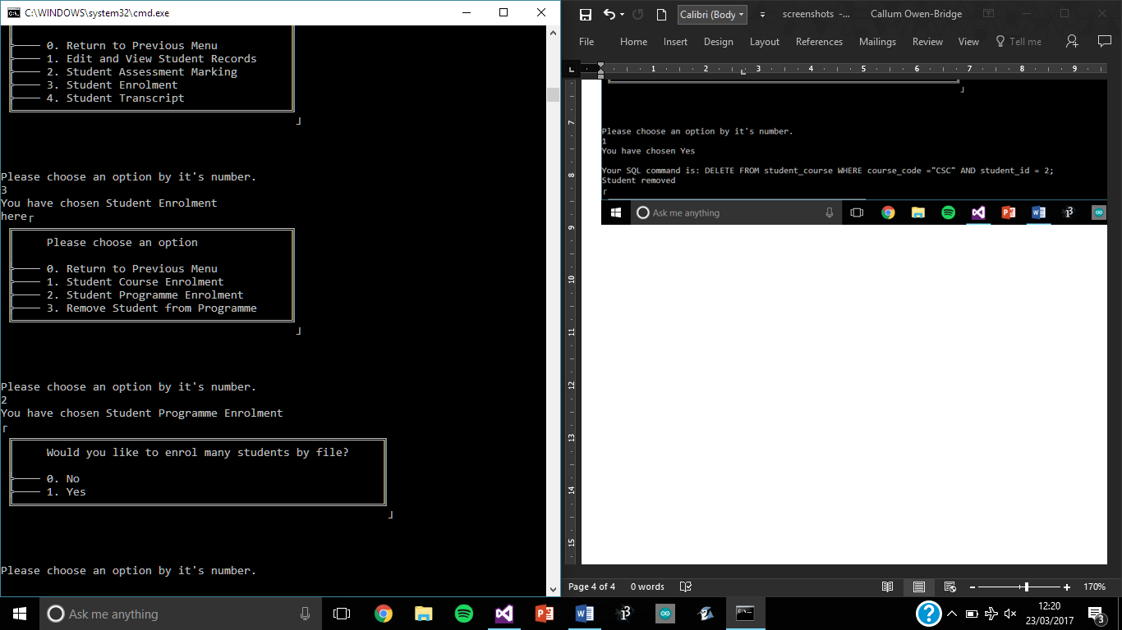
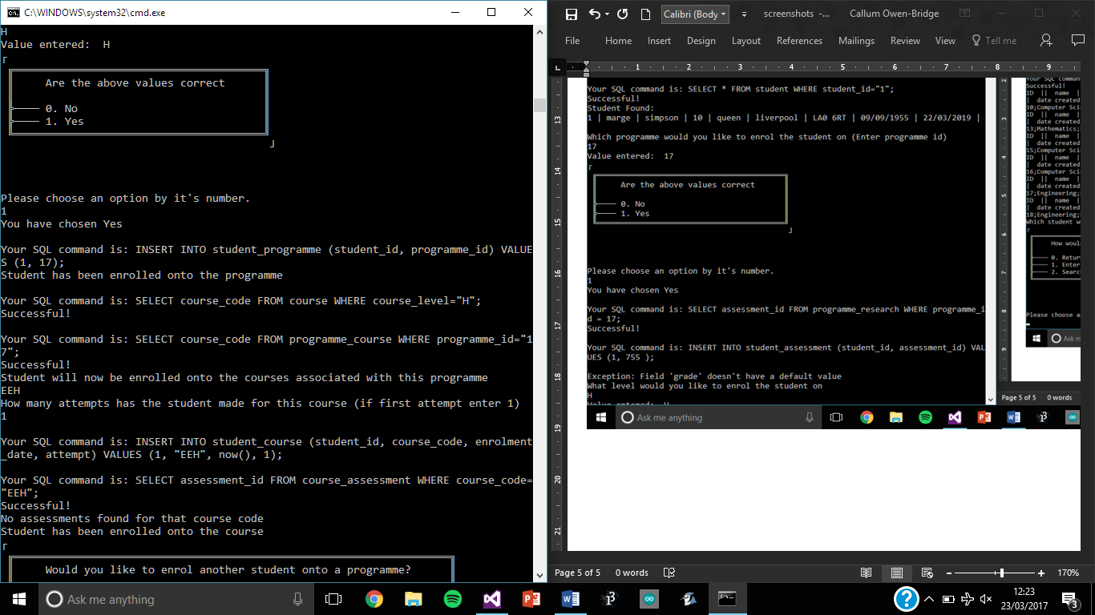
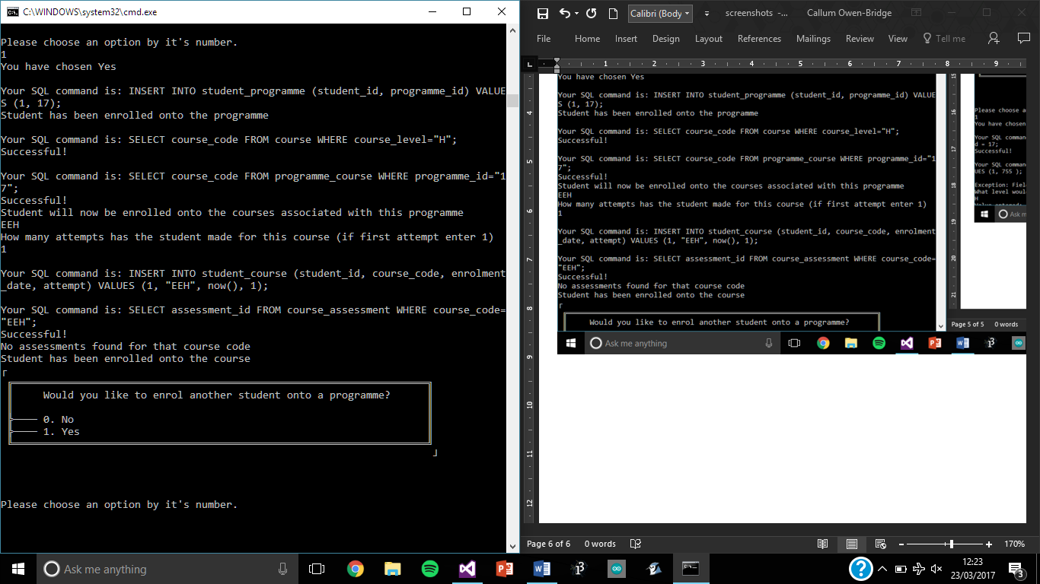
Enrolling students onto a programme
Individually

Slide 39
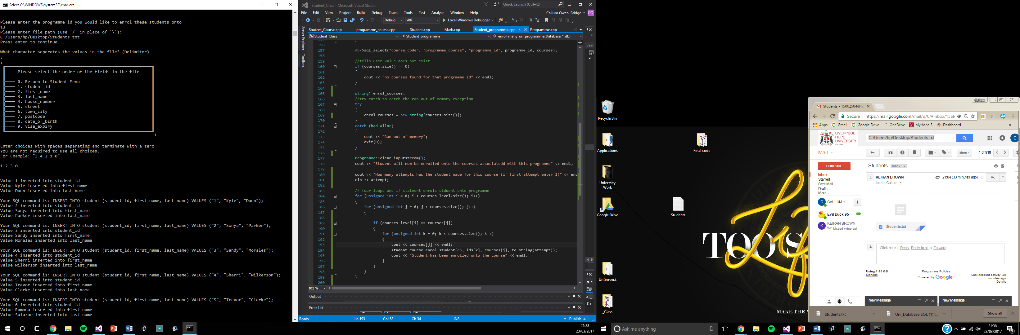
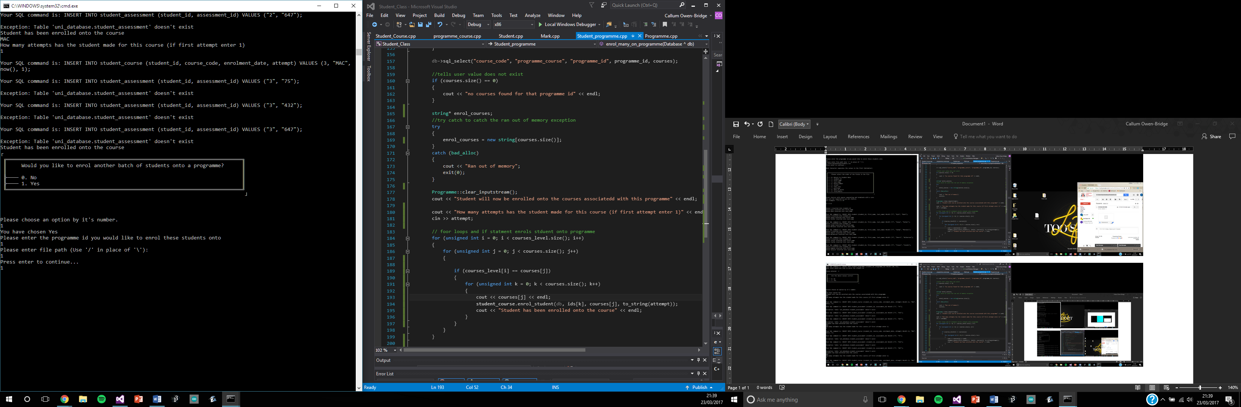
Enrol students onto a programme
By file
Programme id
Level
Attempts

Slide 40
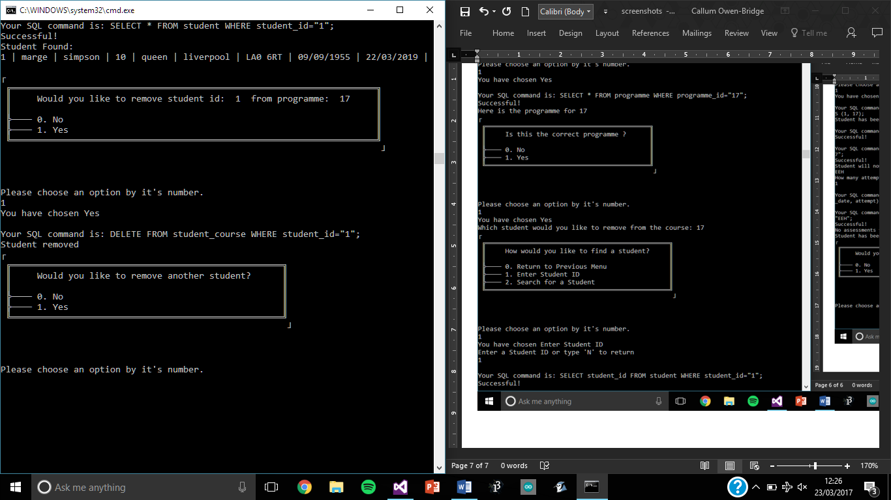
Remove student from programme
Displays student details
Input check

Slide 41
Student Course Options

Slide 42
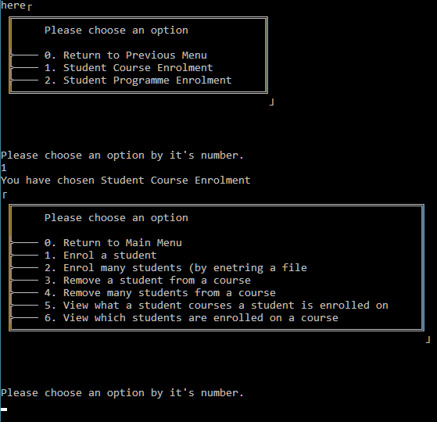
Enrolling students onto a course
Enrol individually
Enrol a batch of students
Remove students from a course
View a student’s course list
View students on a course

Slide 43
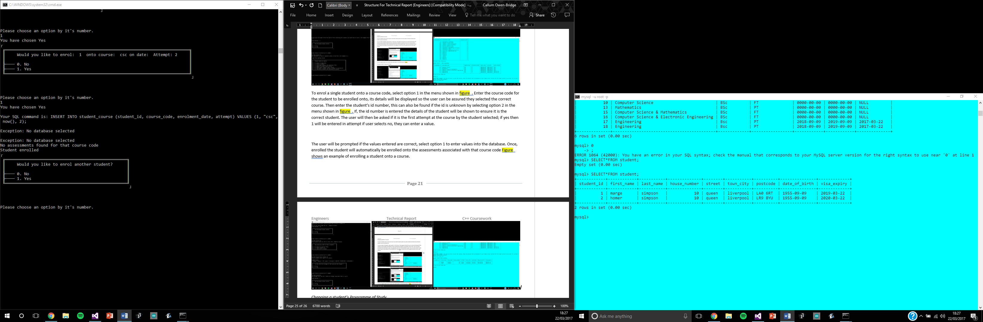
Enrol individual students
Both course and assessments

Slide 44
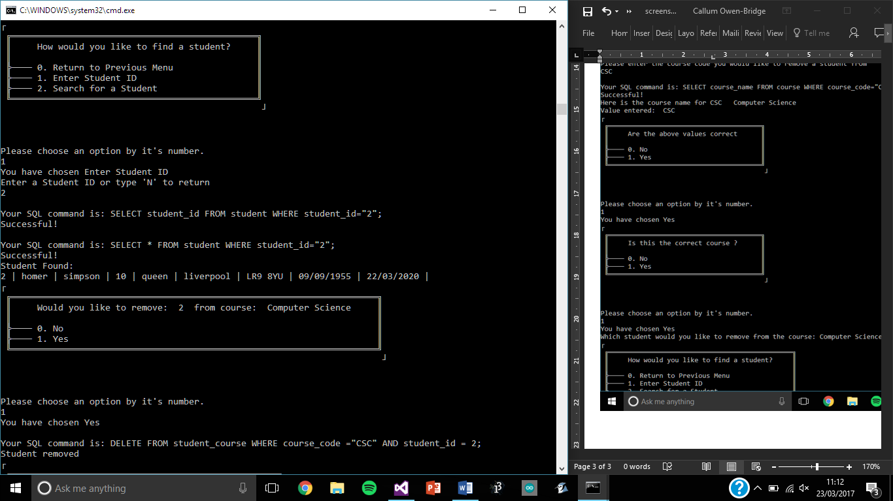
Remove a student from a course
Individually
Or remove many using a file

Slide 45
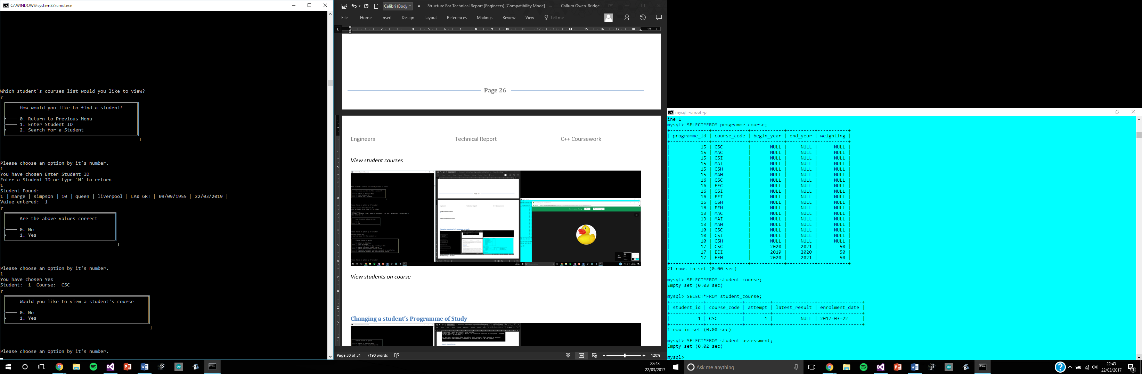
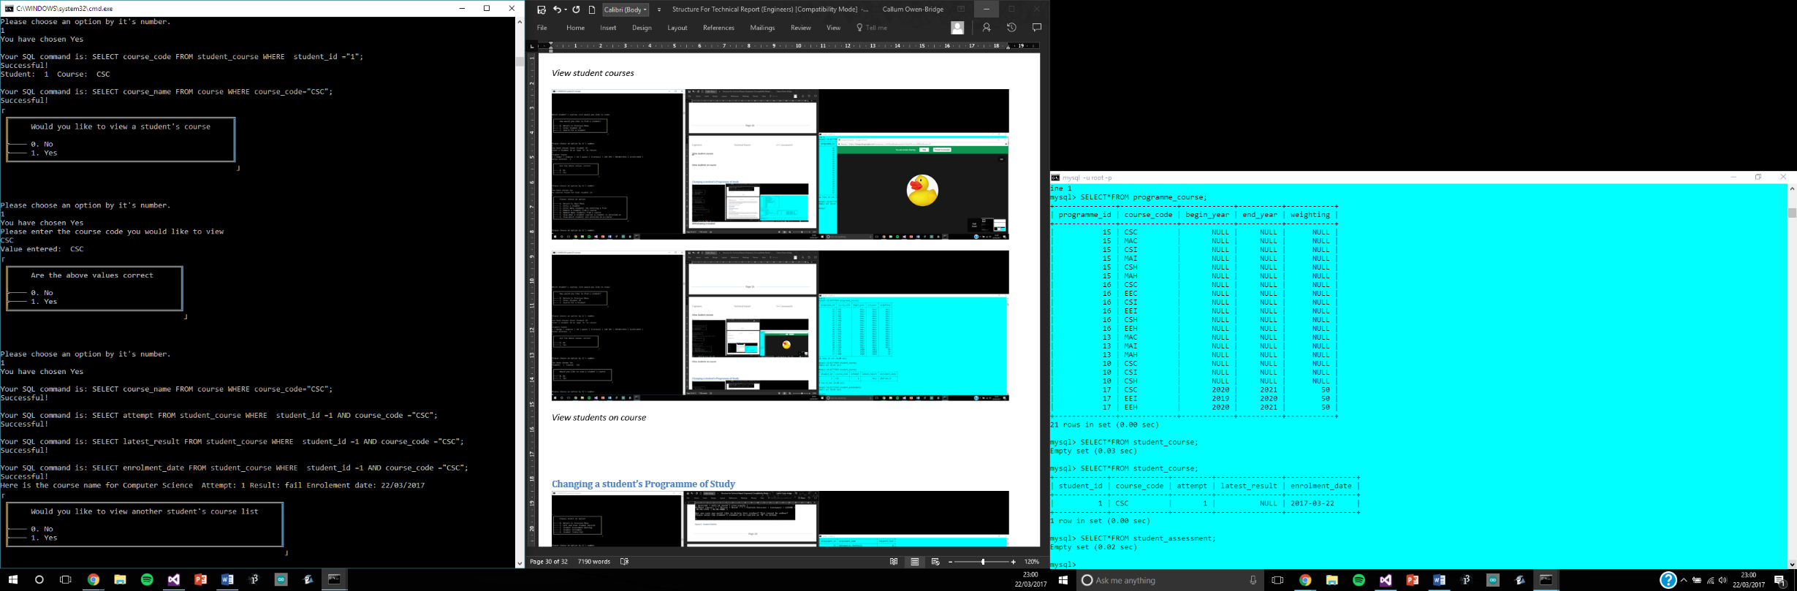
View student courses – Courses

Slide 46
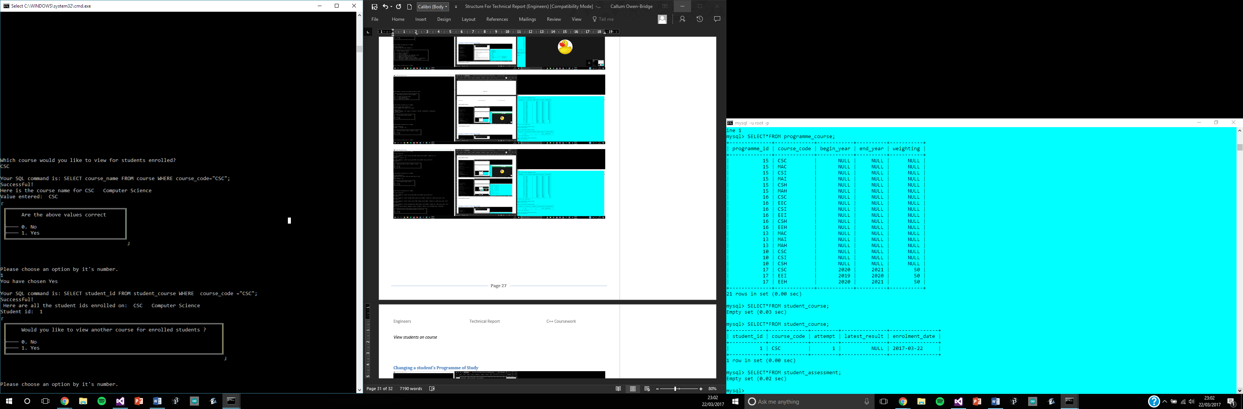
View student courses – Students

Slide 47
Marking assessments options

Slide 48

Assessment marking
View assessment mark
Add assessment mark
Amend assessment mark
View course mark
View overall level mark

Slide 49

View assessment mark
Displays :
Student details
Assessment details
Student’s assessment mark

Slide 50


Add assessment mark
Concessional codes
Automatic grade, result calculation

Slide 51


Amend assessment mark
Automatic course mark calculation

Slide 52

View course mark

Slide 53

View level mark

